Slide 1
An IoT - Baby Monitor
Computer Architecture Winter 2016
Qian Wang

Slide 2
Overview – Monitor baby while not present
Remotely detect that baby is crying.
Monitor and analyze baby’s sleep pattern.

Slide 3
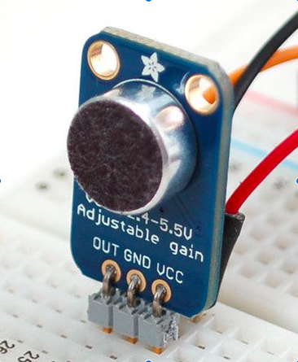
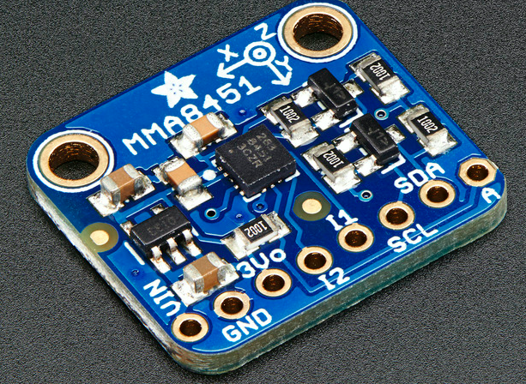
Sensors
Sound Detector
Electret Microphone Amplifier - with
Adjustable Gain (MAX4466)
. Read from ADC pin
. Safe with 2.4 - 5V power (best 3.3 V)
Motion Detector
Adafruit Triple-Axis Accelerometer - ±2/4/8g
(MMA8451)
. Communicate over I2C
. Safe with 3V or 5V power

Slide 4
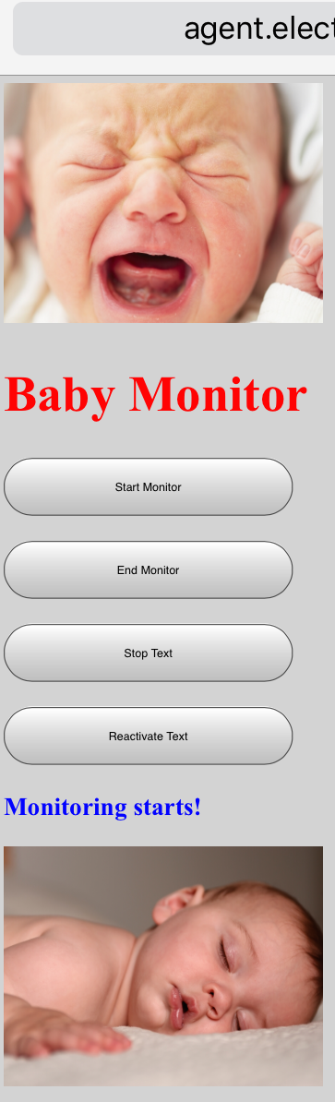
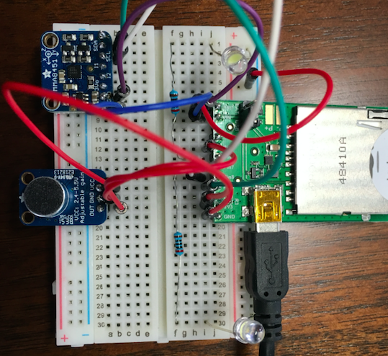
IMP controller
Agent :
Webpage: control device status/text status; Twilio API(SMS); Keen.io API(data for analysis)
Device:
MAX4466(read sound); MMA8451(read motion)

Slide 5
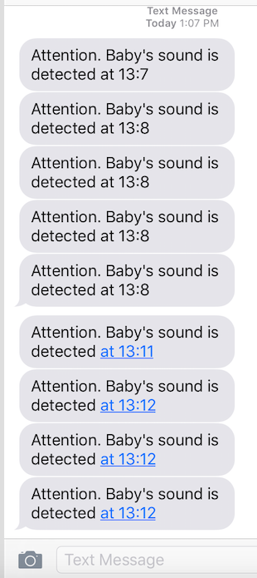
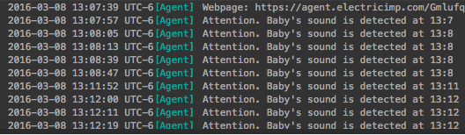
Sound–activated SMS - MAX4466 + twilio API

Slide 6
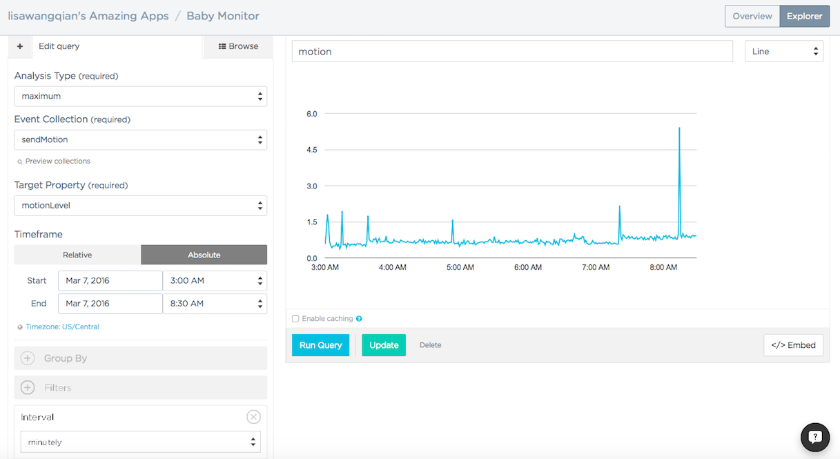
Sleep Pattern Analysis- MMA8451 + Keen.io API

Slide 7
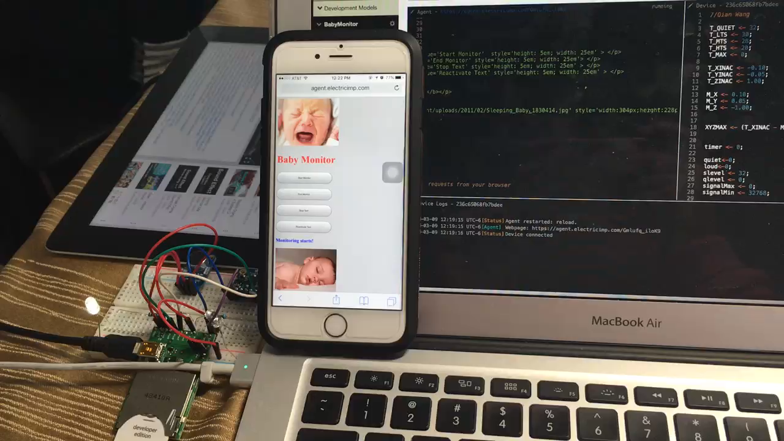
Demo

